Slide 1
Southern Water Corp – Technical Presentation
Date: 4/23/20
Presenter: Jake Ehlers

Slide 2
An increase in the coming year of forecasted maintenance costs (~30%) due to major outages has raised concern for controlling operational costs and preventing asset failure for the Surjek Desalination Plant by determining which variables may drive an asset failure.
!
With water demand increasing, water production was 96 GL over the forecast in 2013-2014 (~1%) which resulted in an increase of revenues of $16.4 M (~3%) over the 2013-2014 year¹.
Increased water demand has led to maximizing desalination plant availability to meet the continual demand.
!
The age of the Surjek Plant is concerning, as one of the chief scientists noted particular signatures around a number of pumps that provided abnormally high-pressure readings which can indicate a system failure.
Plant availability has contributed to increased worry about system failure and outages at the Surjek Desalination Plant.
!
With plant maintenance already forecasted to increase by ~31% in the coming year, plant outages would increase that even more². With the plant already being out of operation in January - April for maintenance, losing more water production should be prevented.
System failure and outages would lead to increased maintenance costs as well as a loss of revenues.
Note: ¹ Information has been sourced from Financial Data 2013-2014
Note: ² Information has been sourced from Economics Data 2013-2014 and Economics Forecast 2014-2015
Notes:
What problem we are approaching
TITLE

Slide 3
Through utilization of descriptive and inferential statistics, five variables correlated with the Surjek Pump Failure event, enabling development of a multivariate equation able to identify abnormal Surjek Pump behavior.
Surjek Flow Meter 1, Surjek Flow Meter 2, Rotational Pump RPM, Surjek Pump Torque, and Maximum Daily Pump Torque are the variables that correlated with the Pump Failure event, and should be inspected and/or repaired to potentially prevent future asset failure.
Using descriptive statistics and visual aids, observing the variable behavior between failure and non-failure states showed a noticeable difference between values.
Applying inferential statistics, the variables showed a moderate to strong correlation with the Pump Failure event and were used to build a regression equation to attempt to predict future abnormal behavior.
Source: Southern Water Corp Statistical Records
Notes:
Key findings
TITLE

Slide 4
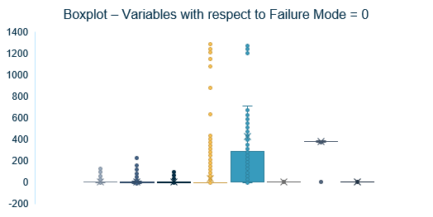
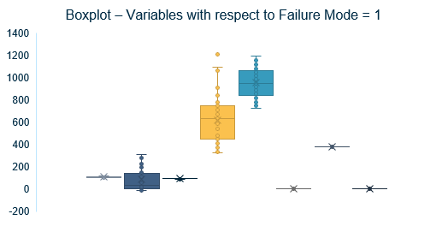
Splitting the data into two sets, one aligned with Pump Failure and the other not, yielded 5 variables that had shifted in the corresponding boxplots, indicating potential correlation with Pump Failure.
Key Insights
Surjek Flow Meter 1 and Rotational Pump RPM don’t look to change much between boxplots because of the axis size, but when looked at on its own we see a more noticeable difference between failure and non-failure states.
Removing outliers didn’t have a great effect on the Failure Event dataset, however had an impact on the Non Failure Event dataset.
Source: Southern Water Corp Statistical Records
Notes:
Diving deeper into the descriptive statistics:
TITLE
Shift in 5 variables
Flow meter 1 and Rotational pump RPM on its own change more
Removed outliers to see how affected the visual, minimal impact on failure event data
Many outliers on non failure event data could be abnormal behavior that wasn’t a part of pump failure
Raw time plot with all variables to see how they move in response to pump failure, see spikes for all 5 variables at the pump failure moment
Found Standard deviation of the data to see variability of data. Plotting the failure event time frame we see Flow Meter 2, Pump Torque, and Maximum Daily Pump Torque increase during failure, suggesting the values are moving further and further away from the mean.
These descriptive techniques showed some variables that seemed to relate to pump failure, so look further into it with inferential techniques

Slide 5
Further analysis of the dataset yielded four variables that had a moderate correlation with the Pump Failure variable, and one variable where the variability had a strong correlation, which adds to the confidence in the trends observed in the descriptive statistics analysis.
Key Insights
Surjek Flow Meter 1, Surjek Flow Meter 2, Rotational Pump RPM, and Surjek Pump Torque have a moderate correlation (0.3<p<0.7) with the target variable.
Using our variables to create a linear regression equation, we observe an Adjusted R² of 0.575, which suggests our model would be relatively accurate in predicting a pump failure.
Source: Southern Water Corp Statistical Records
Notes:
Looking at the data and applying inferential techniques
TITLE
Correlations of variables as well as correlation of rolling standard deviations of variables
Standard deviation of Maximum daily pump torque has a strong correlation of 0.82 with Pump failure
To make the graph we made a correlation heatmap of the variables and looked at the correlation of each variable with Pump Failure variable
As well correlation heatmap of the rolling standard deviation of each variable to see how variability correlates with Pump Failure
Using a regression function with excel, compared regression statistics between the original data set as well as the rolling standard deviation to find the better fit to the Pump Failure variable.
Adjusted R square of standard deviation data was 0.575, which is a moderate fit, while the original dataset was 0.264, so the first one is a better fit.
Next look at the actual regression equation graphed with pump failure to set the fit.

Slide 6
Utilizing the regression equation, the line indicated two other moments that could have led to a pump failure, so maintenance should check to see if a failure event was not recorded.
Source: Southern Water Corp Statistical Records
Notes:
Our inferential statistics led to this regression equation
With an R squared of 0.575, the regression moderately predicts and explains the pump failure variable. We also see a lower standard error in 0.025, so 95% of our data should fall between approximately plus/minus 0.05 of the regression line.
For all variables, their p – values were less than 0.05 so they all were meaningful additions to the regression.
We see in the graph that the model spikes at the same time as the pump failure
TITLE
According to the model, approximately a 10% chance of failure at the two other spikes.

Slide 7
Using descriptive and inferential statistics, five variables correlate with the Pump Failure event and a regression equation was generated that has the ability to identify potential abnormal pump behavior.
Key Takeaways:
Surjek Flow Meter 1, Surjek Flow Meter 2, Rotational Pump RPM, Surjek Pump Torque, and Maximum Daily Pump Torque all correlated with the failure event and corresponding parts/devices should be checked and fixed.
The regression equation predicts the failure event that occurred, however it also pointed out two other time periods of abnormal behavior. These moments could be the precursors to a failure event, or actually could have been a failure event, so going back to check if failure events actually occurred during those time periods would be beneficial.
Notes:
In conclusion
TITLE
THANK YOU
R squared – proportion of variance in the dependent variable that can be explained by the independent variable
Standard error – the average distance observed values fall from the regression line
Rolling standard deviation, why period of size 30

